Slide 1
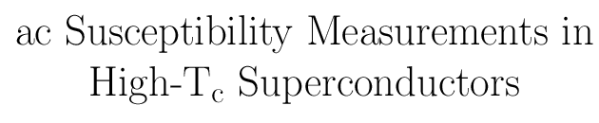

Slide 2
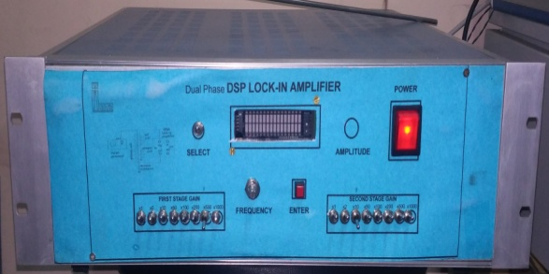
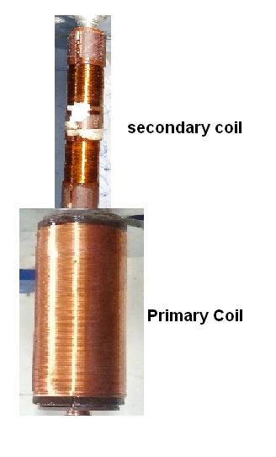
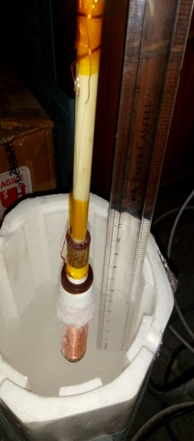
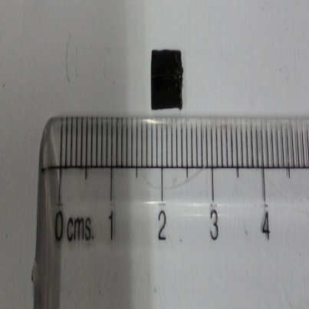
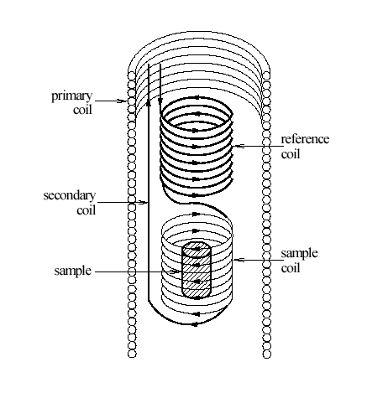
Sensor built-in-house to measure magnetization of Hi tc sample
DIP IN LN2-77K
AND LIFT IT UP
( 77K- 300K)
Sample and T-sensor
Yttrium barium
copper oxide(YBCO)
Hi-Tc Superconductor
DIFFERENTIAL TRANSFORMER
WOUND IN LAB

Slide 3
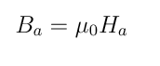
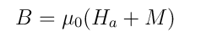
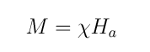
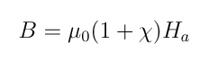
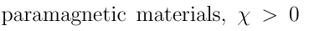
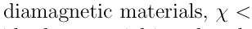
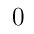
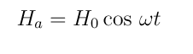
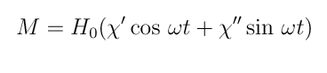
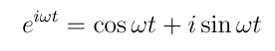


Slide 4
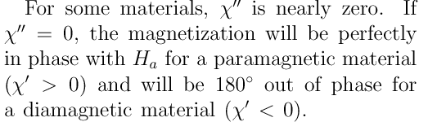

Slide 5
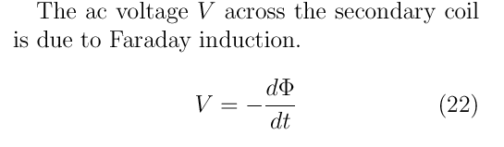

Slide 6
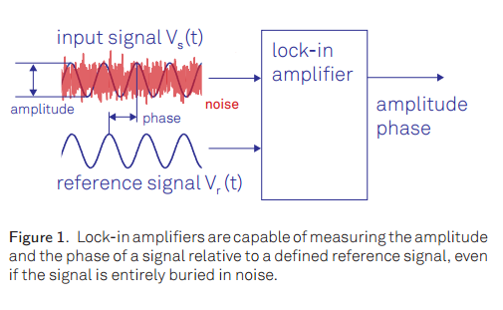
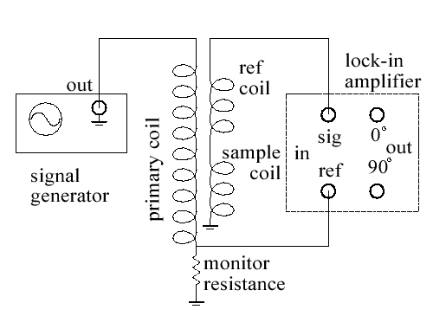
How to measure magnitude and phase of AC output when noise is much much
more than the signal ( of the order of 1000 times more noise)

Slide 7
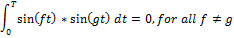
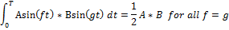
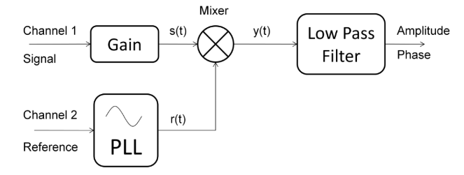
Lock-in What is it?

Slide 8
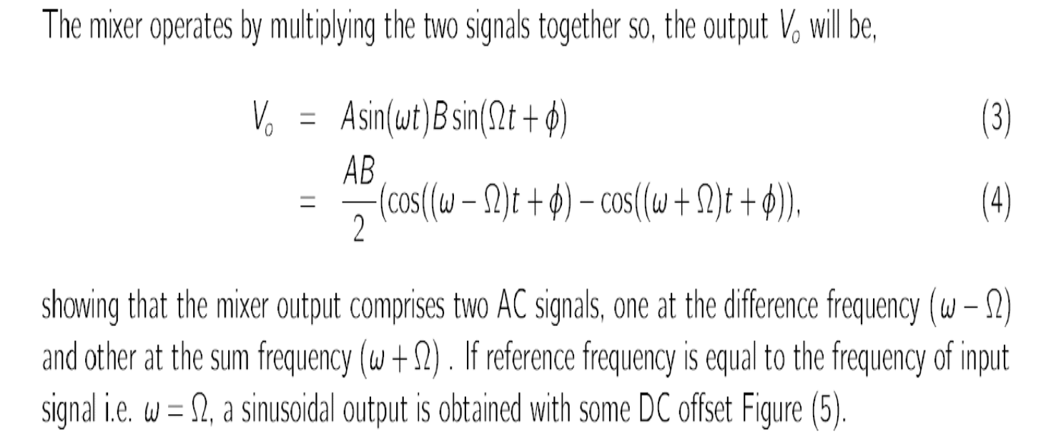

Slide 9
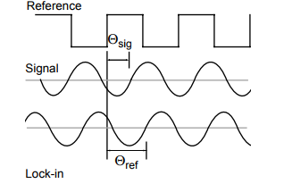
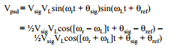
PSD

Slide 10
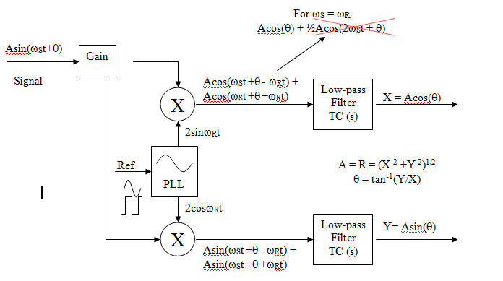
A lock-in amplifier acts as a narrow band-pass filter (as narrow as 1 mHz) around the reference signal frequency.

Slide 11
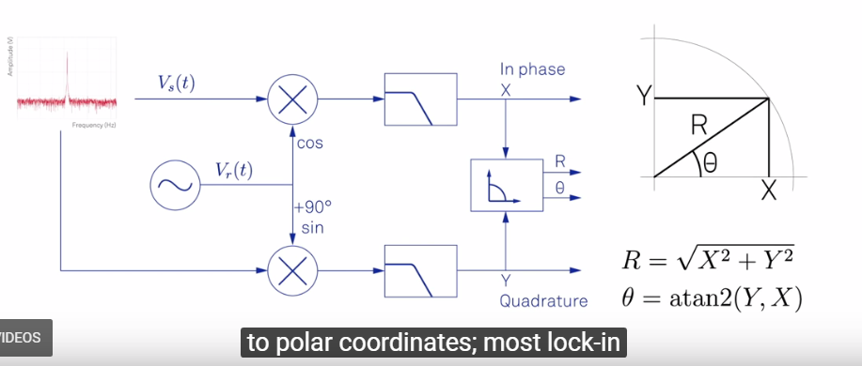

Slide 12
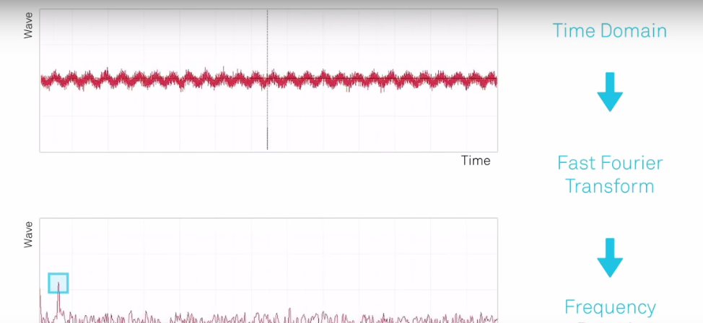
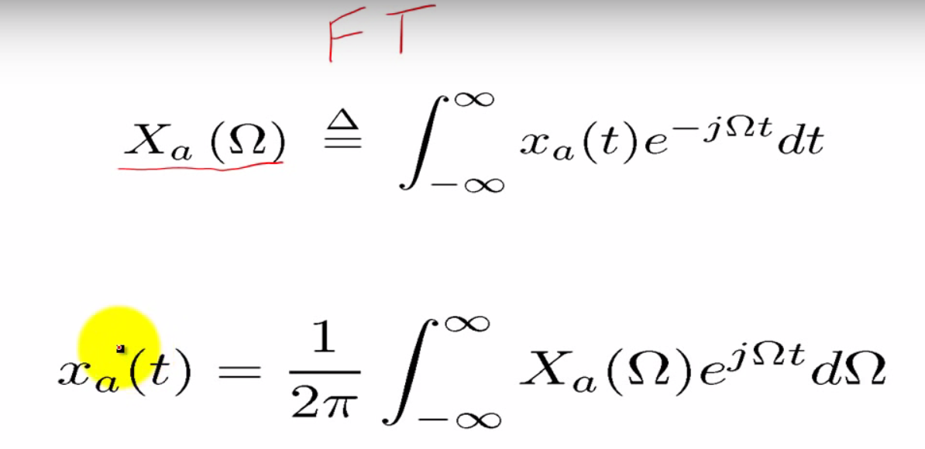

Slide 13
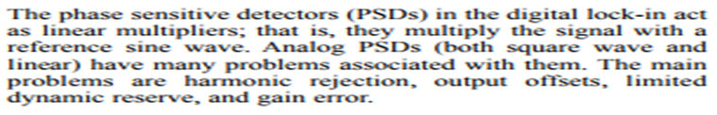
Why DSP ? Why not analog?

Slide 14
-DSP lock-in amplifiers provide a large dynamic range >120dB.
-No temperature drift in digital
-Synthesized Waveform generators are used
-DSP lock-in amplifiers generally more accurate than analog lock-in amplifiers, primarily to the fact that they produce less harmonic distortion in the PSD section
-They provide more flexibility in terms of filter customization
-Linear Phase IIR filters
-Making frequency mixers are easier
-PLLs are more easy to implement in digital

Slide 15
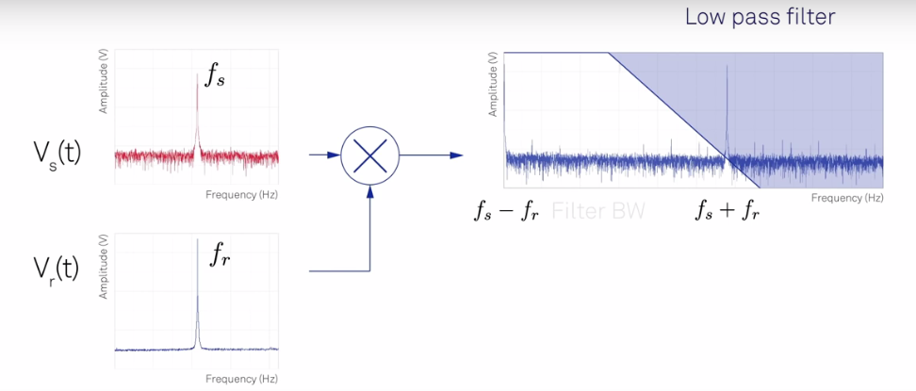
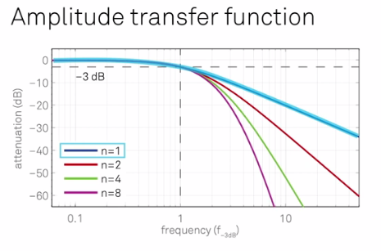

Slide 16
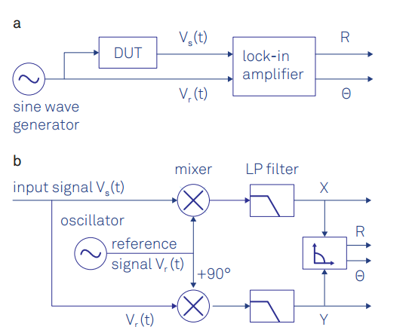
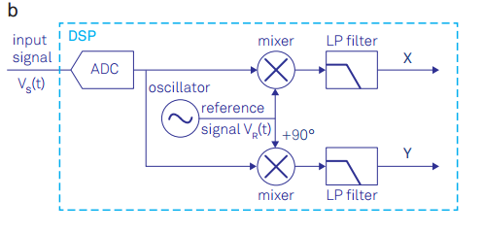

Slide 17
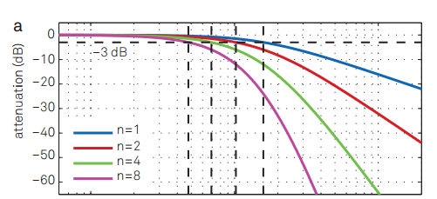

Slide 18
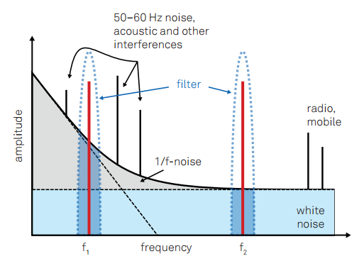

Slide 19
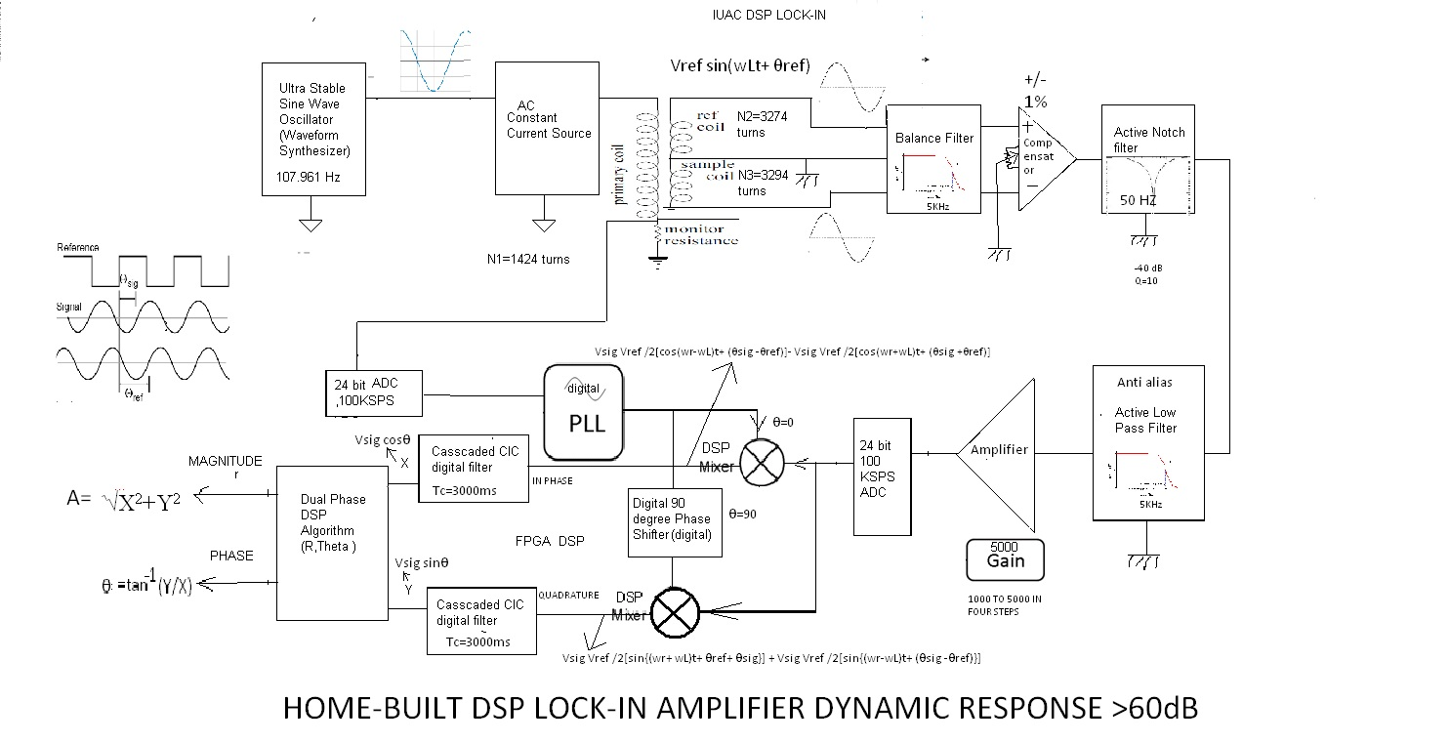

Slide 20
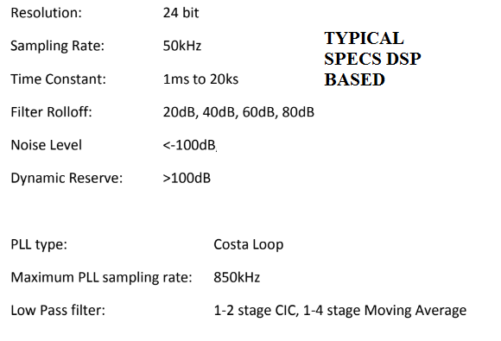

Slide 21

Our very well worked DSP Lock-in

Slide 22
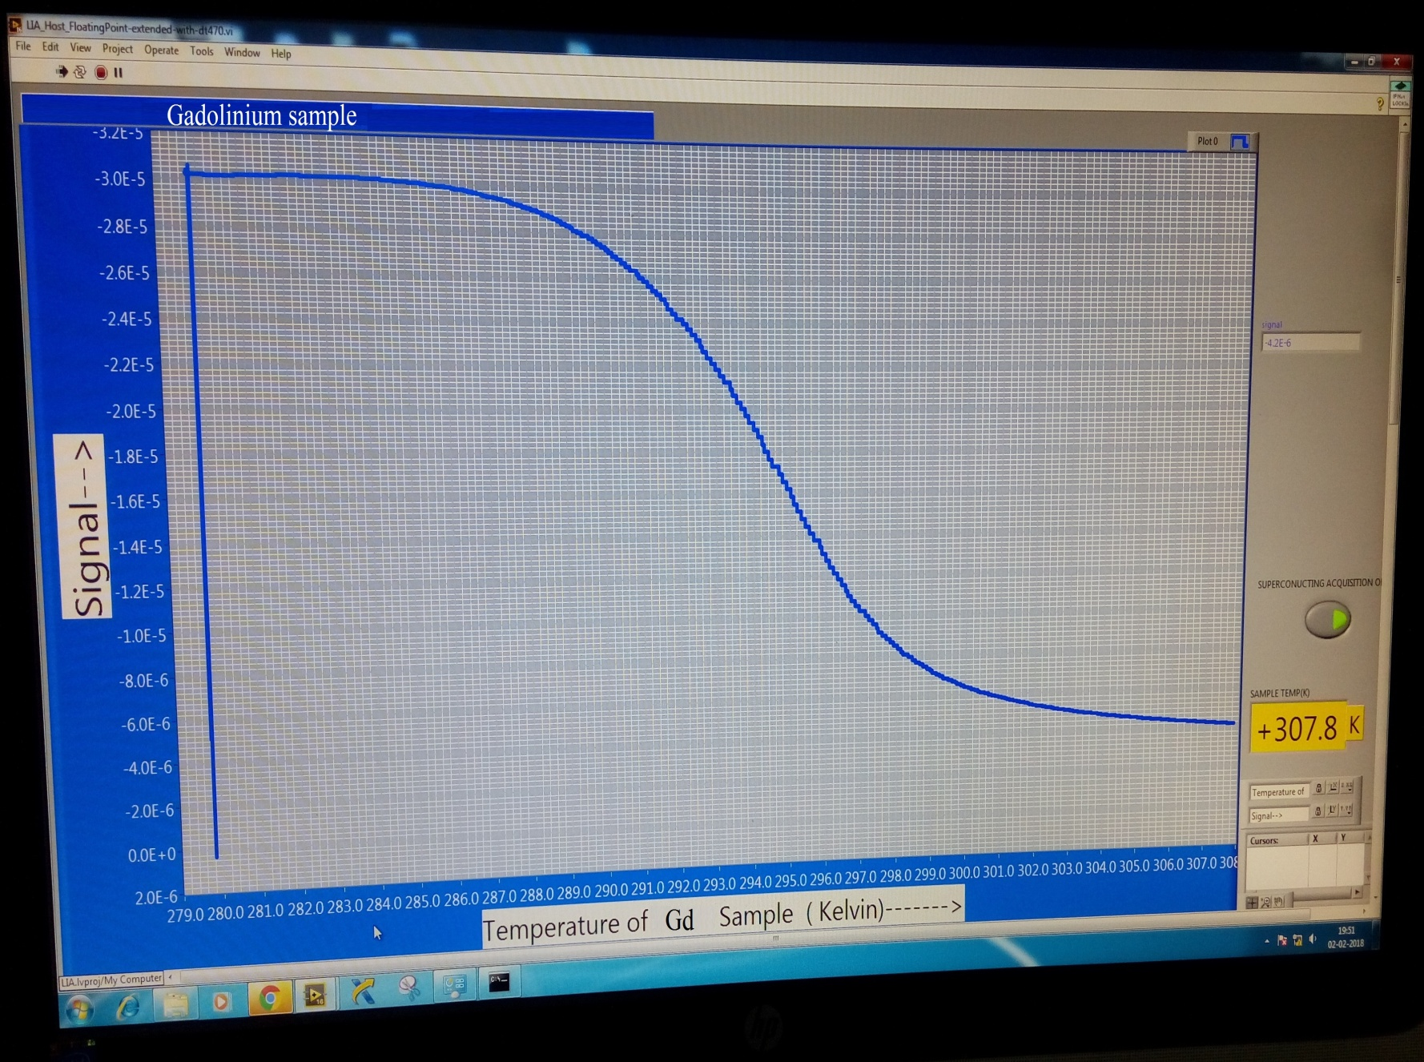
Measuring para to ferro magnetic transition of Gd

Slide 23
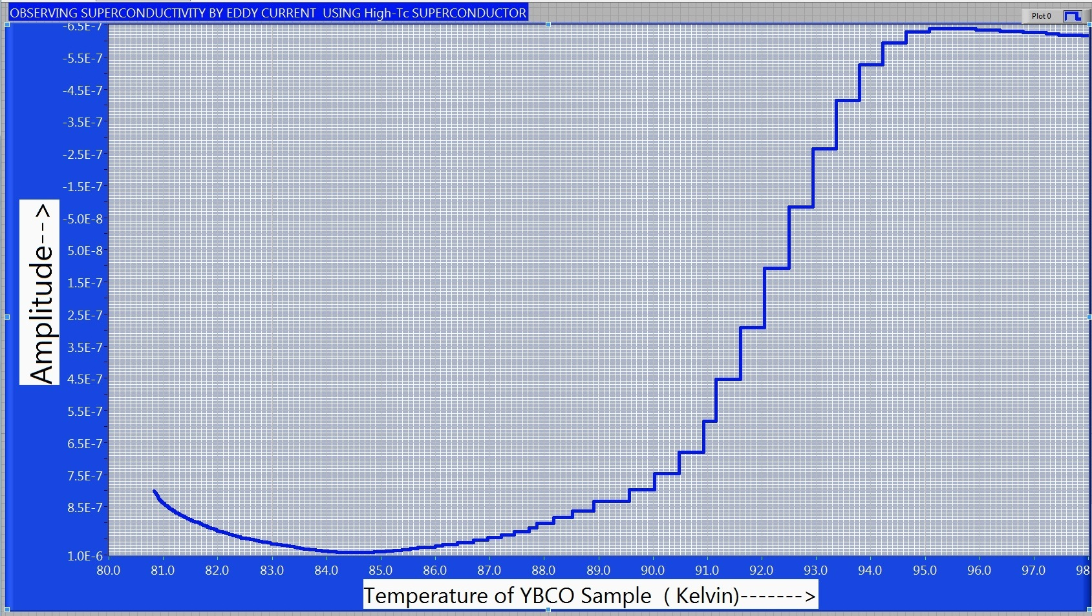
Measuring High tc Super conducting transition
When LN2 is poured on the superconductor, the superconductor is diamagnetic and when temperature of the sample rises above 93 Kelvin ,it becomes paramagnetic

